Slide 1
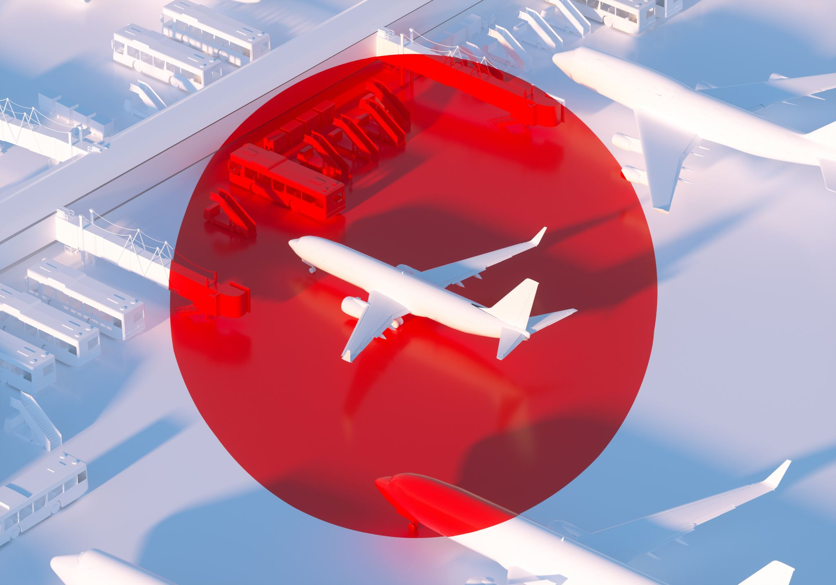
Airline on-time performance analysis
Szymon Hryniewski
Mateusz Kierznowski

Slide 2
Strategies of the biggest American airlines

Slide 3
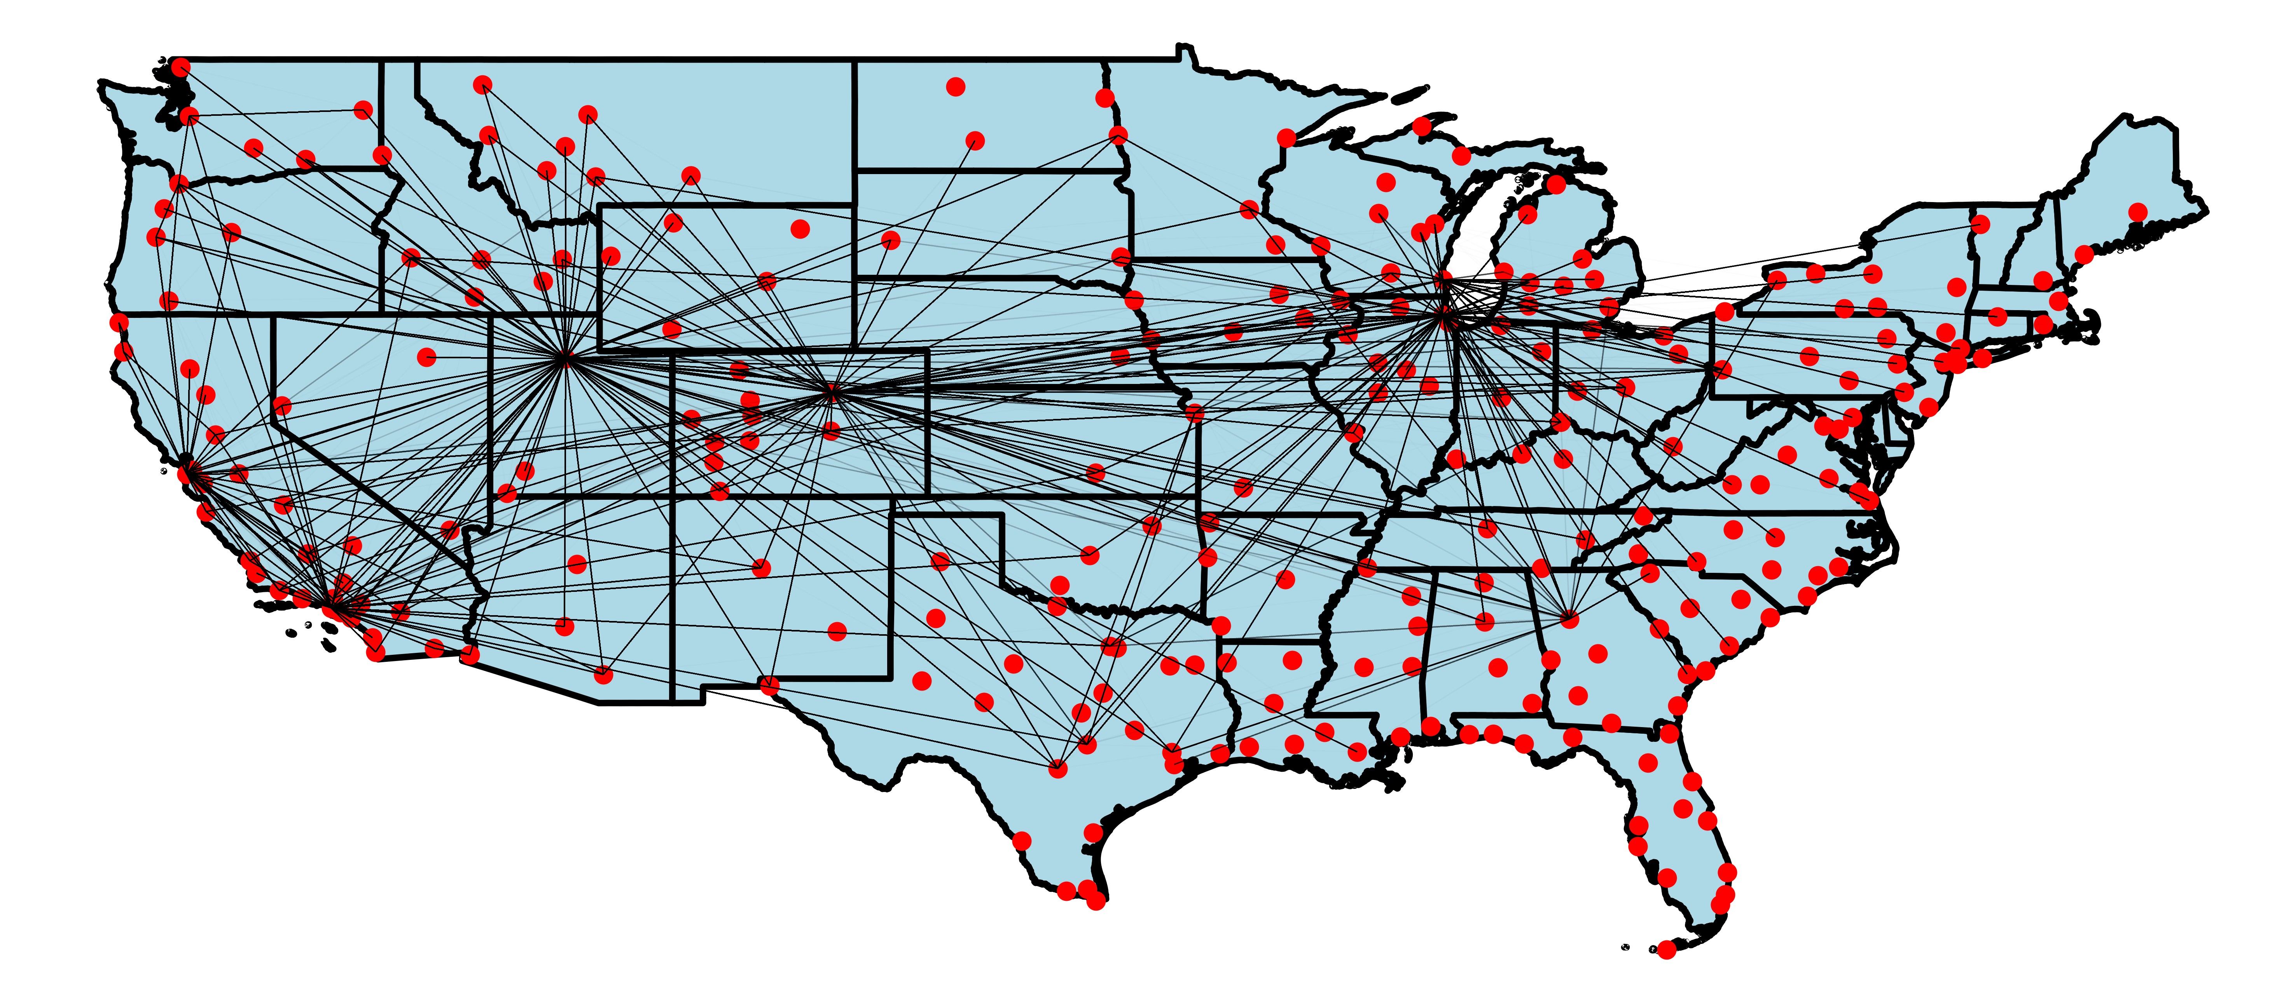
Skywest Airlines Inc.

Slide 4
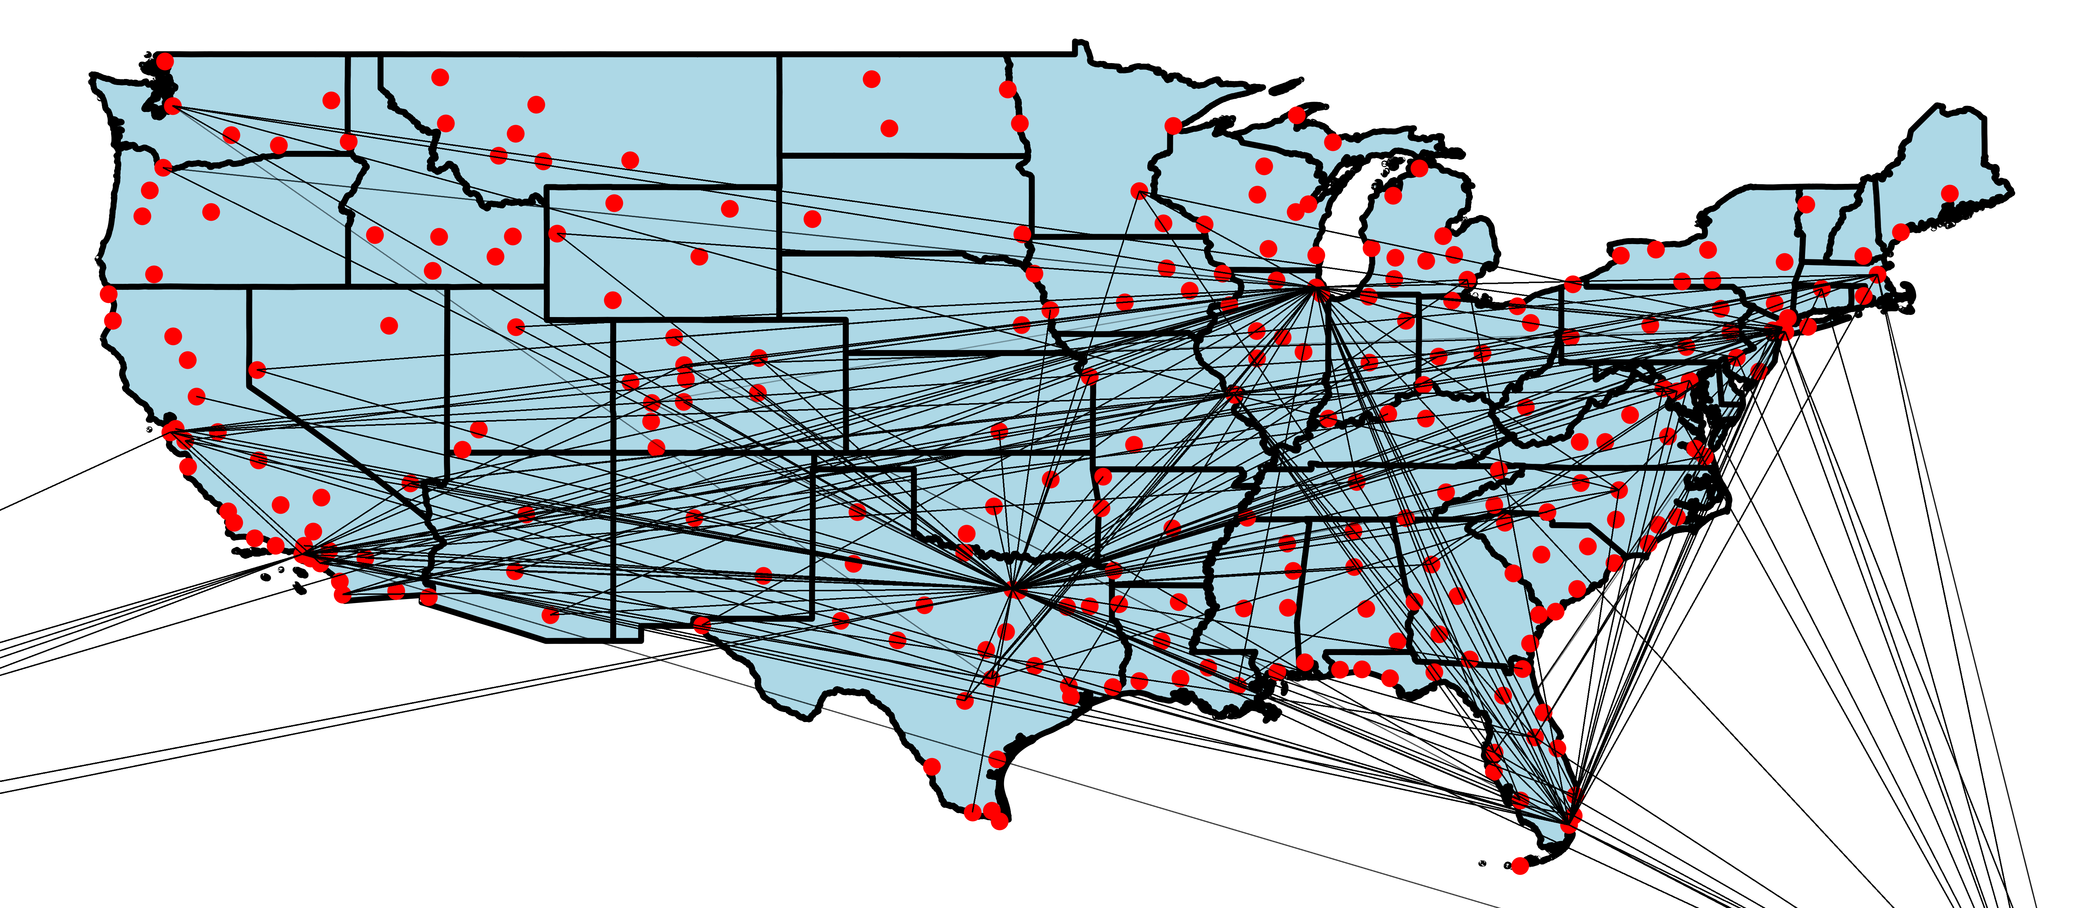
American Airlines Inc.

Slide 5
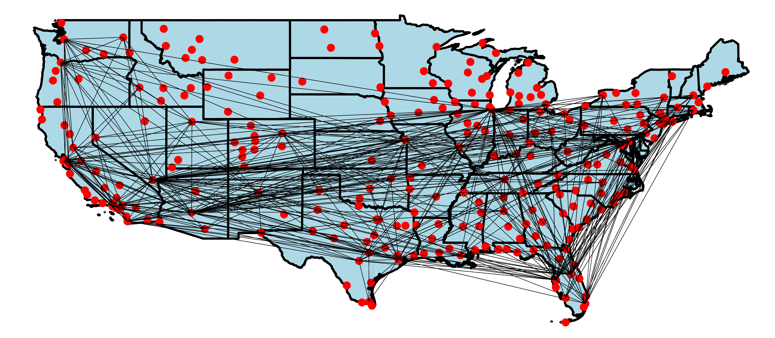
Southwest Airlines Co.

Slide 6
Interesting strategies of small airlines

Slide 7
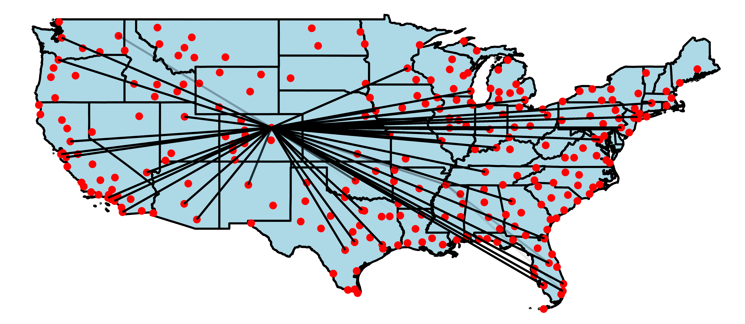
Frontier Airlines Inc.

Slide 8
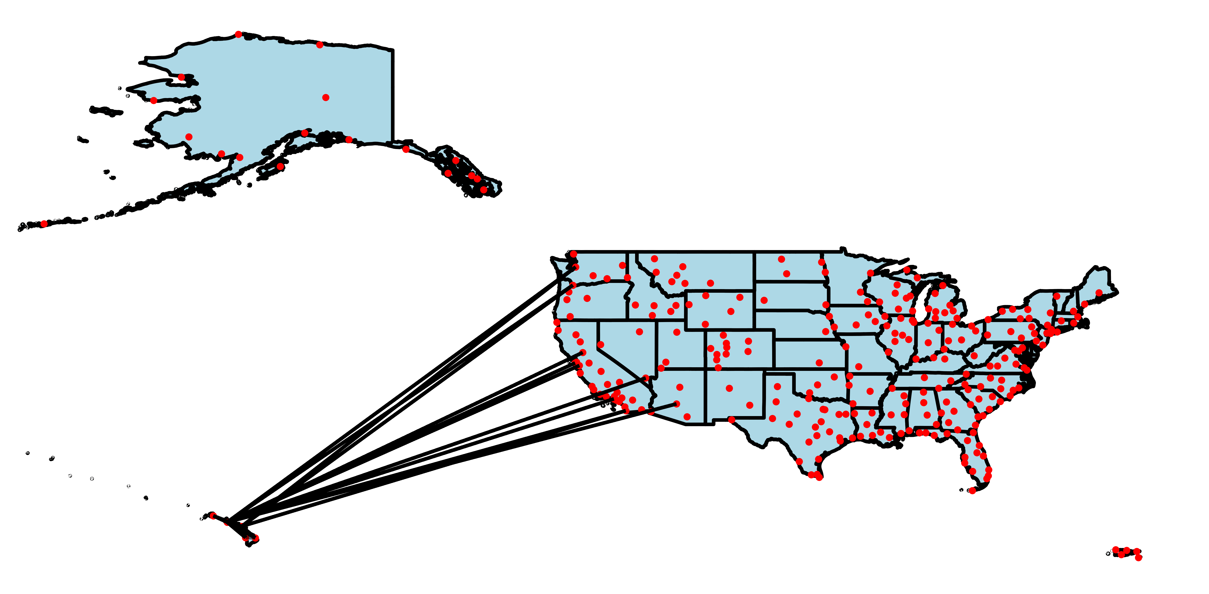
Aloha Airlines Inc.

Slide 9
What are the busiest airline routes?

Slide 10
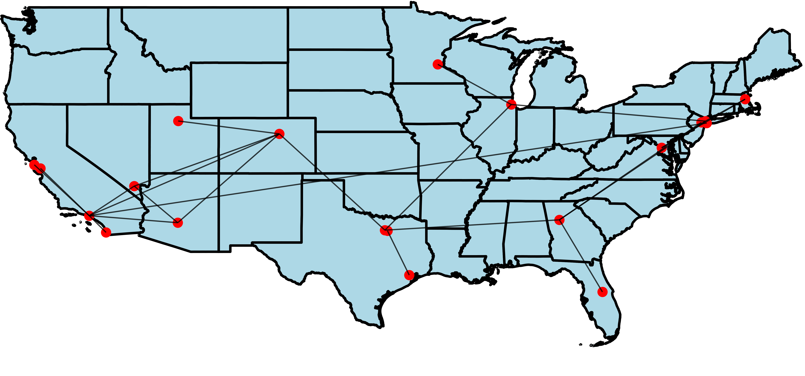
Busiest routes

Slide 11
One-time flights

Slide 12
Flight analysis

Slide 13
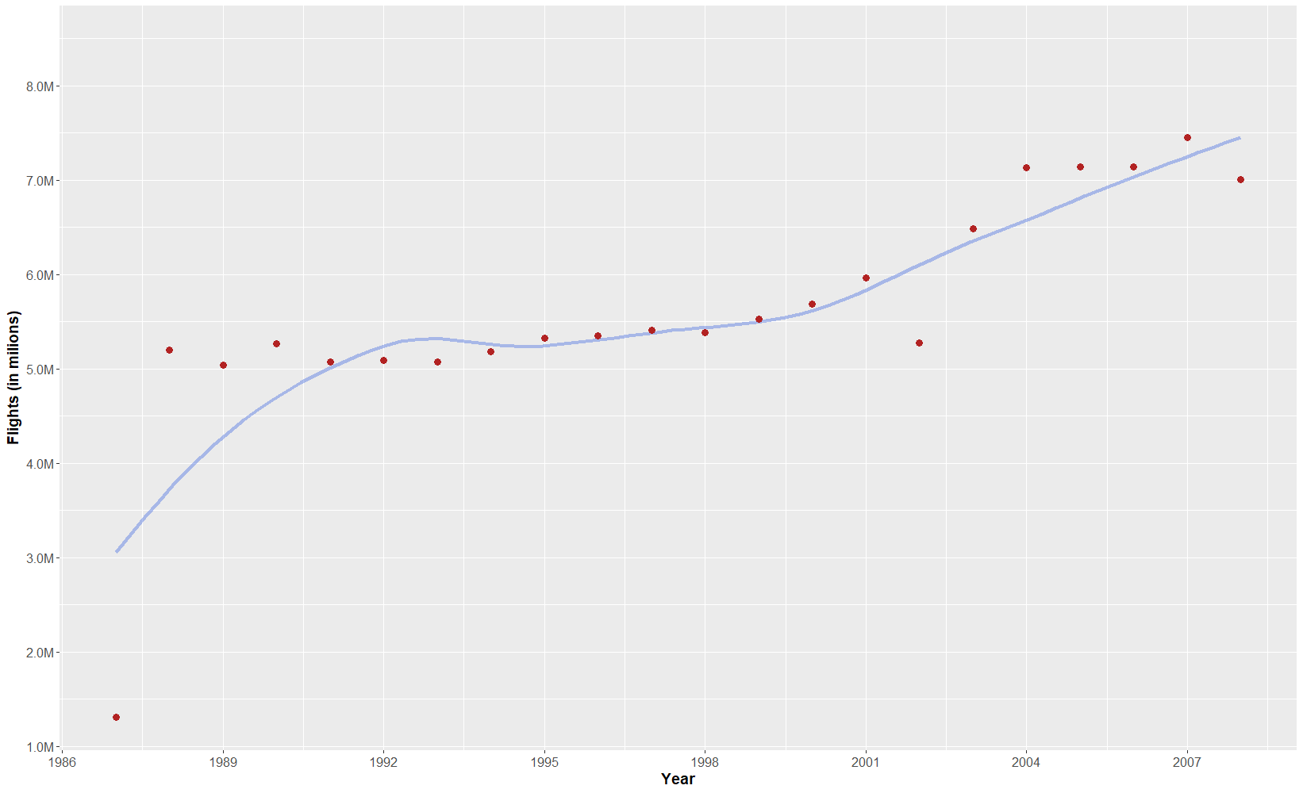
Number of flights per year

Slide 14
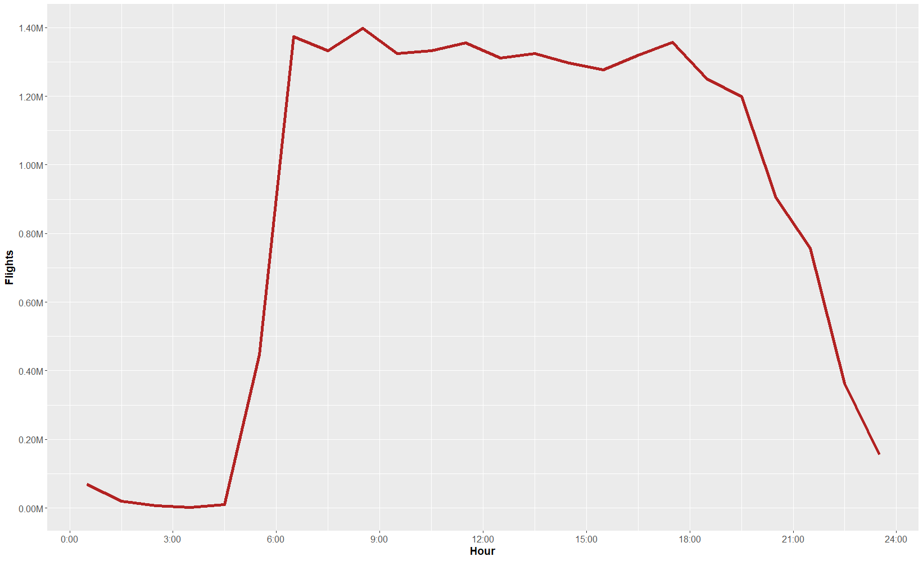
Number of flights per hour

Slide 15
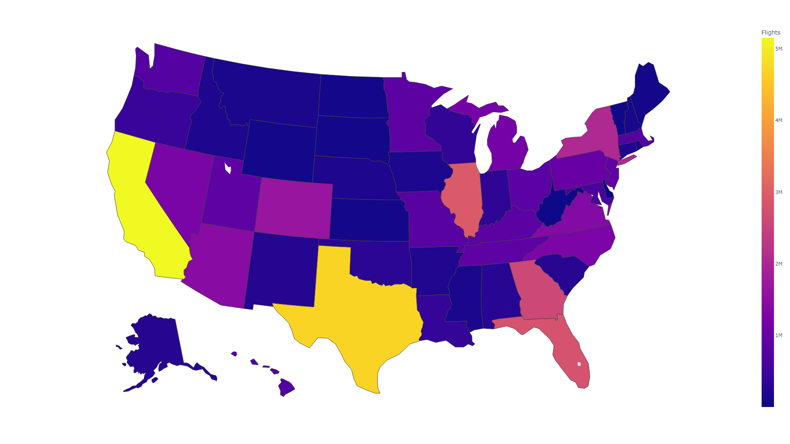
Total number of flights

Slide 16
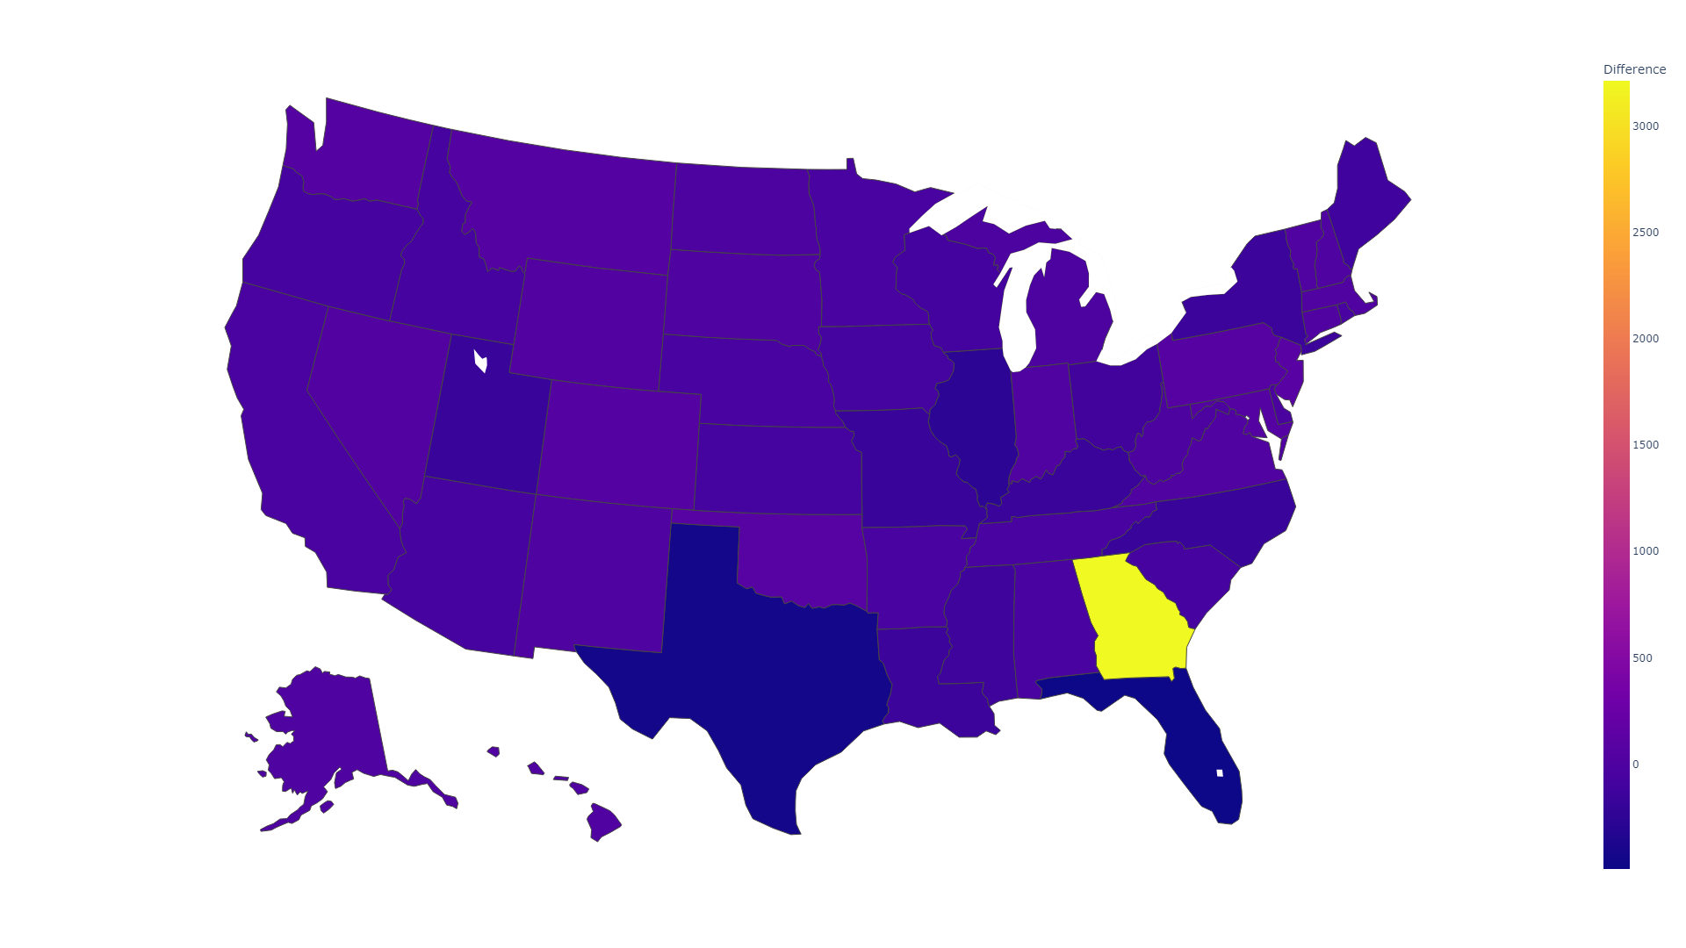
Difference between departures and arrivals

Slide 17
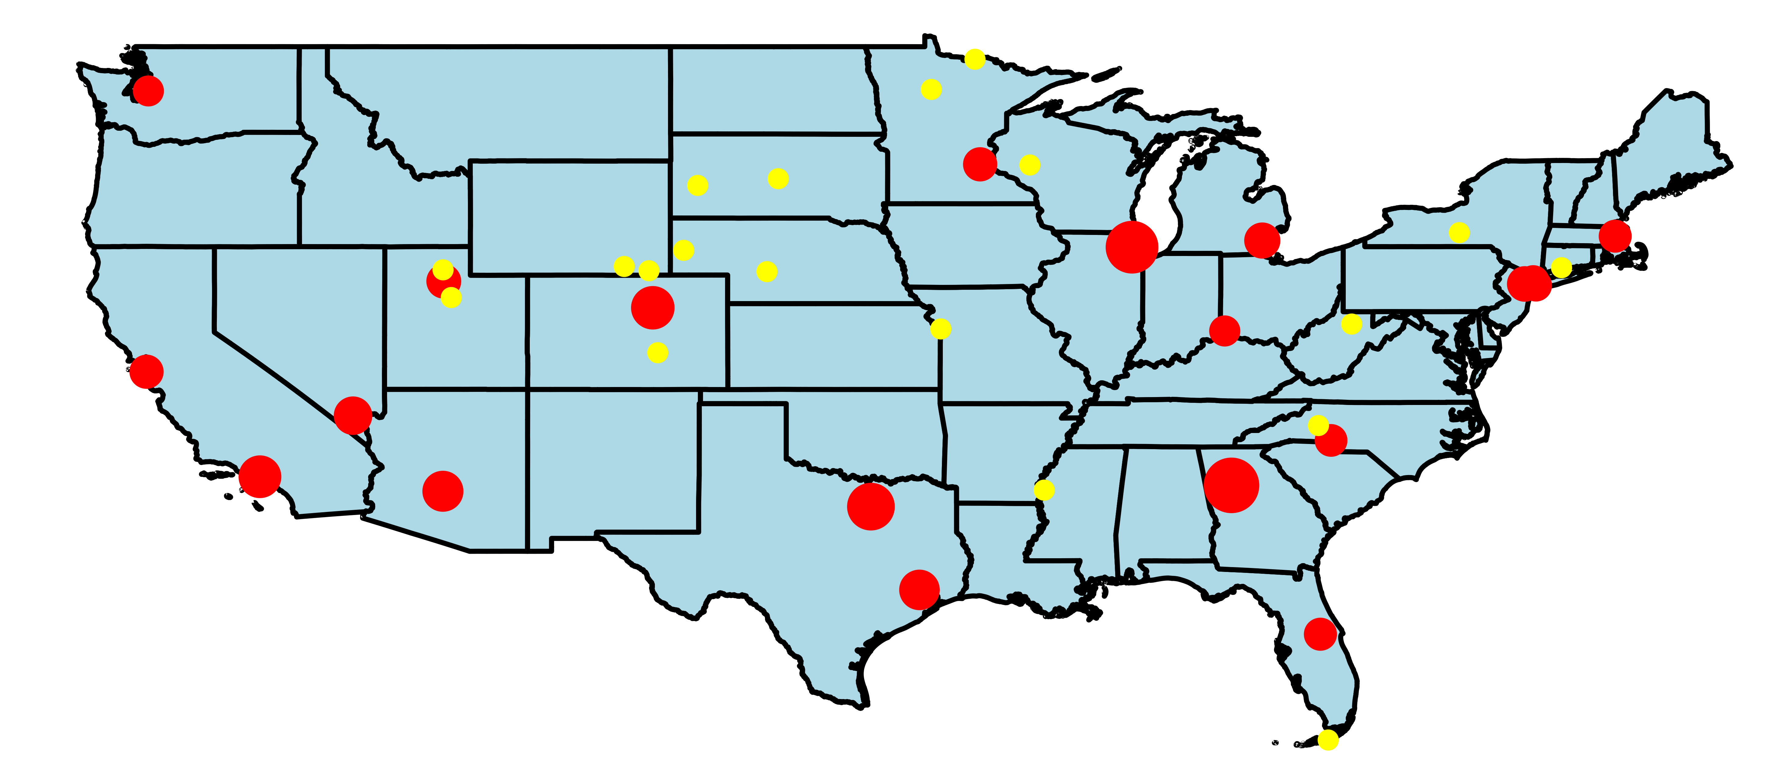
The busiest and the idlest airports

Slide 18
When and where are flights delayed the most?

Slide 19
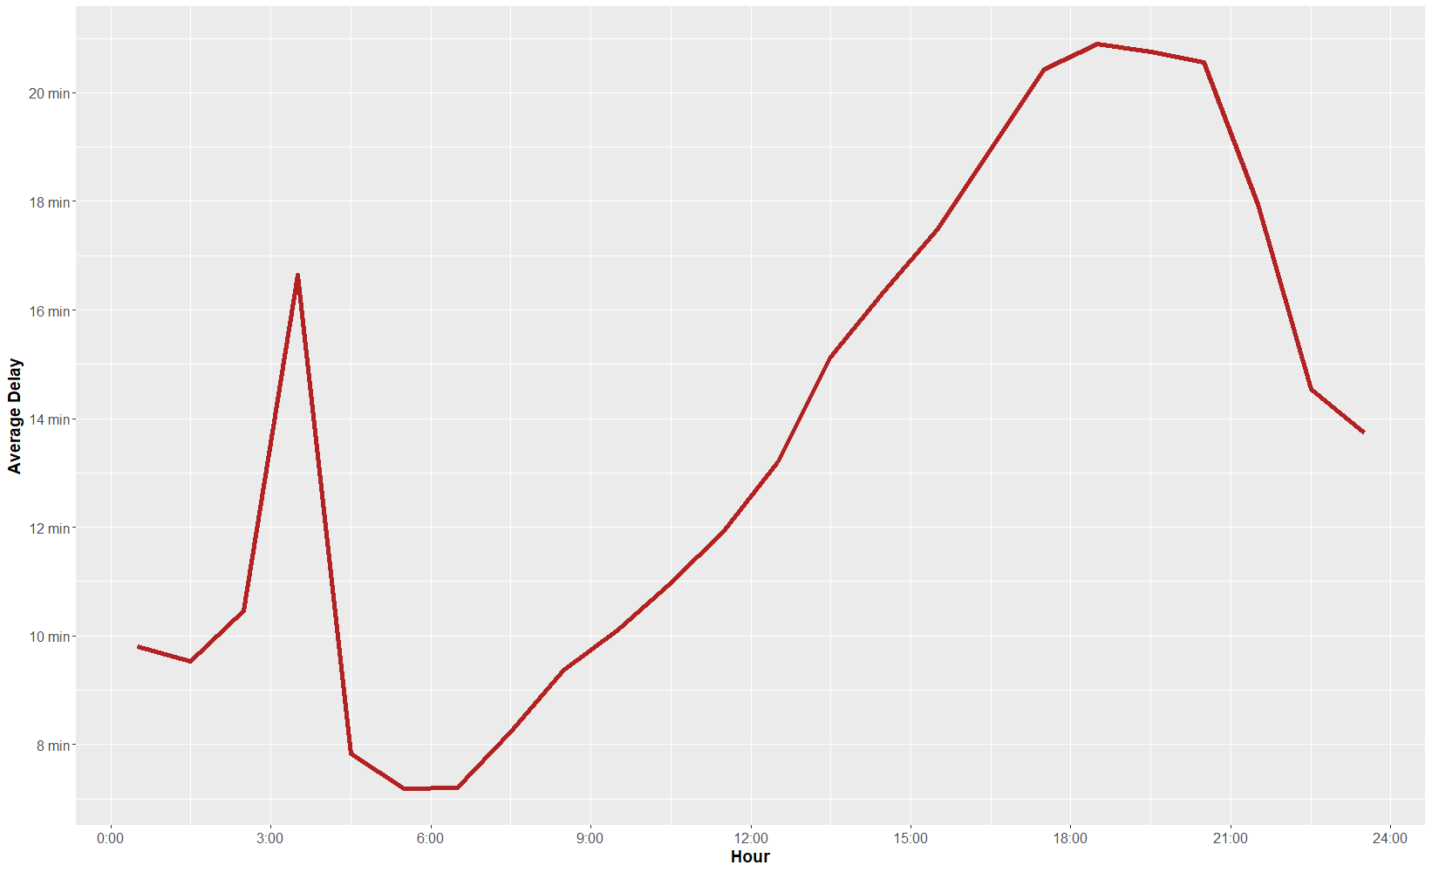
Delays per hour

Slide 20
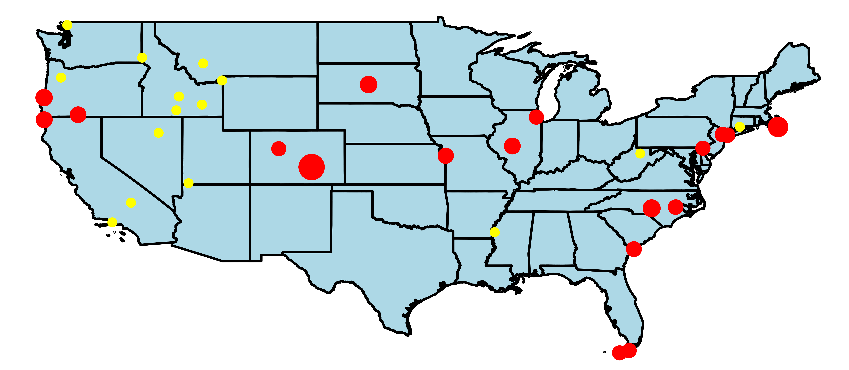
Airports with the longest and shortest delays

Slide 21
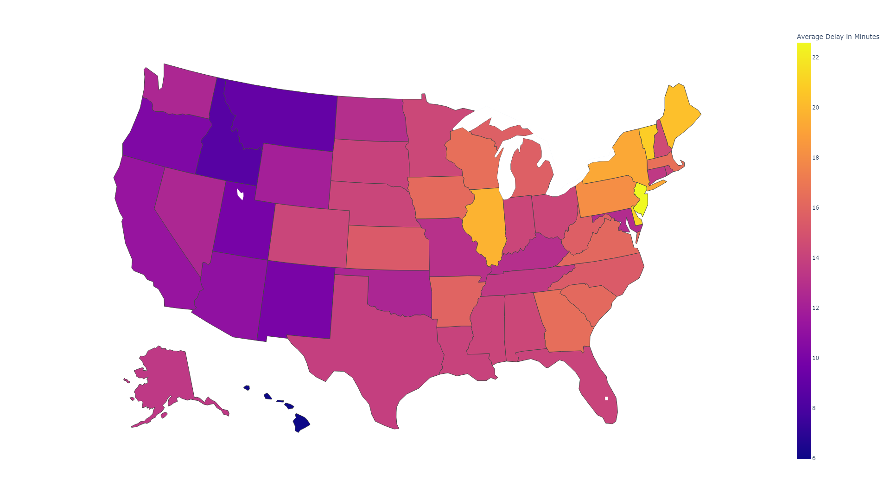
States with the longest and shortest delays

Slide 22
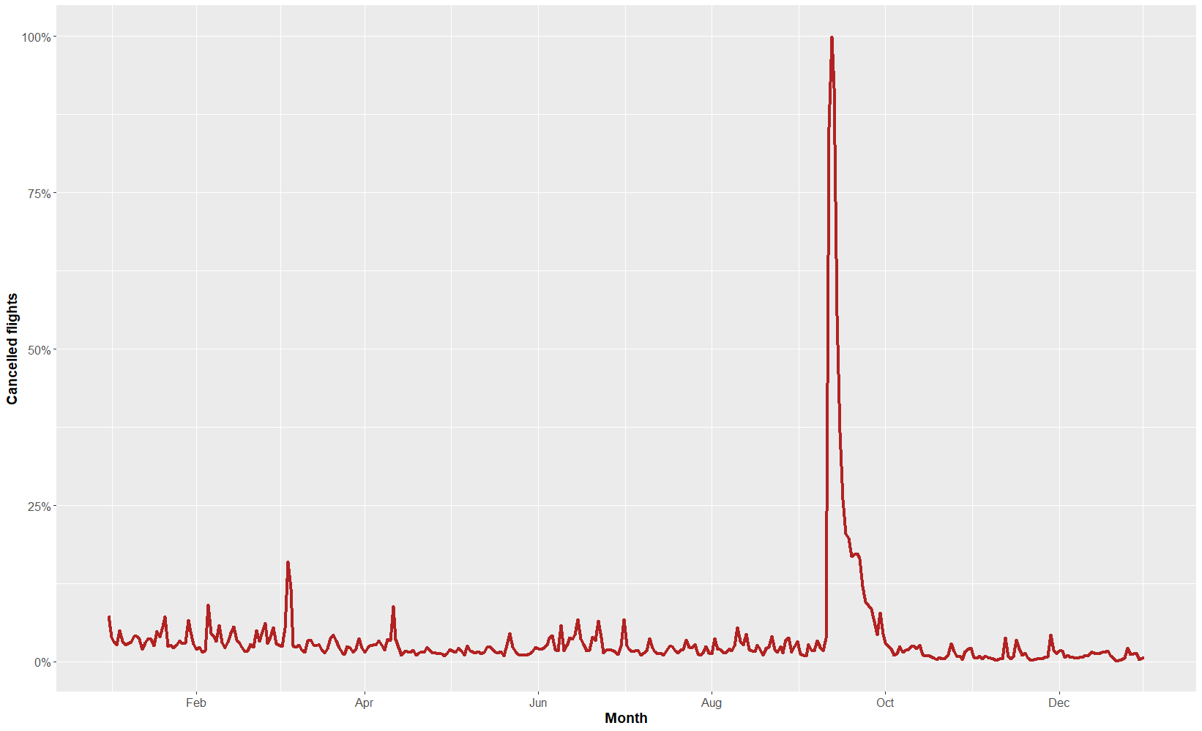
What year is it?

